Slide 1


AWS Meetup Chicago

Slide 2

Who am I
Asaf Yigal
Co-Founder and VP Product @logz.io
Email: asaf@logz.io
Twitter @asafyigal

Slide 3
Agenda
Why do we need Log analytics?
Intro to ELK
What is Logz.io
Installing ELK on your own
Our Architecture
EC2 machine comparison

Slide 4
Why do we need Log analytics?

Slide 5
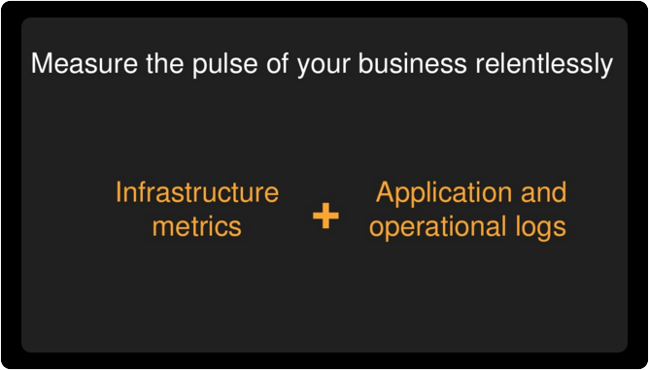

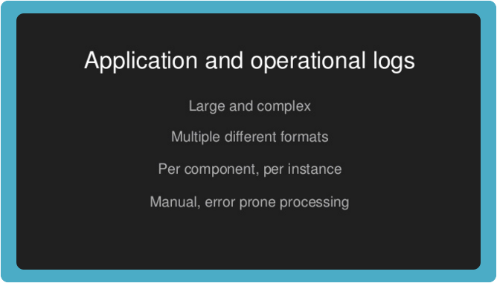
“Log Analytics is Fundamental for
Building Cloud Applications”
Werner Vogels
AWS CTO

Slide 6
Multiple Use-Cases
Troubleshooting
Monitoring
DevOps
IoT
IT OPPS , ITOA
Support
Compliance
SIEM
SecOps
QA
BI
Business
Analysis
Customer
Success
Product
Management

Slide 7
Log driven development
Errors, Warnings and exceptions
Metrics
Alerts
Dashboard

Slide 8
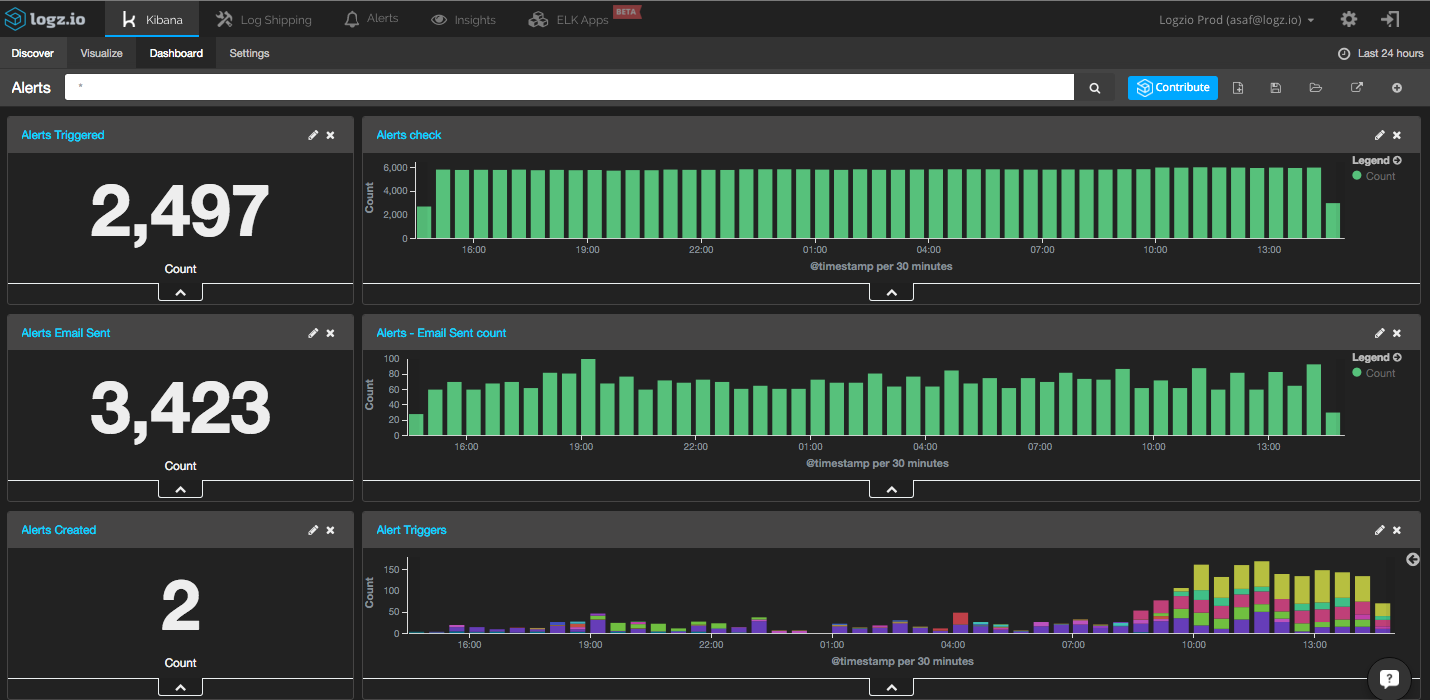

Slide 9
Why
Open Source

Slide 10





The Market is Dominated by Open Source Solutions
*based on Logz.io research
Over the past 3 years, the market shifted attention from proprietary to open source

Slide 11
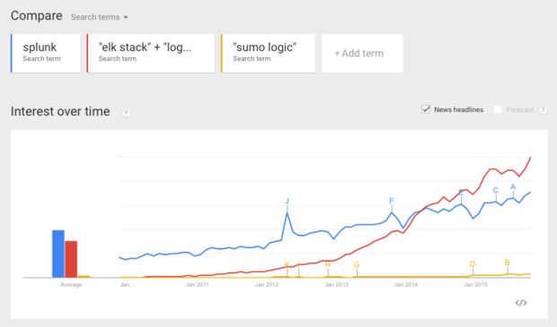
ELK Popularity

Slide 12



Intro to ELK
Logstash
Elasticsearch
Kibana
Streaming data digestion
Time normalization
Field extraction
Schema-less search DB
Highly scalable
Visualization

Slide 13
Open source ELK +/-
Simple and beautiful
Not Production Ready
It’s simple to get started and play with ELK and the UI is just beautiful
Building production ready ELK deployment is a great challenge organization face. With hundreds of different configurations and support matrix, making sure it’s always up is difficult
Open Source
Hard to Scale
The largest user base with a vibrant open source community that supports and improves the product
Data piles up and organization experience usage bursts. It’s super-complex building elastic ELK deployments that can scale up and down
Fast. Very fast.
Poor Security
Built on the Elasticsearch search engine, ELK provide blazing quick responses even when searching through millions of documents
Logs include sensitive data and open source ELK offers no real security solution, from authentication to role based access

Slide 14
Logz.io Enterprise ELK Cloud Service
Up and running in minutes
Alerts
Sign up in and get insights into your data in minutes
Unique Alerts system proprietary built on top of open source ELK transform the ELK into a proactive system
Infinitely scalable
Advanced Security
Ship as much data as you want whenever you want
360 degrees security with role based access and multi-layer security
Production ready
Highly Available
Predefined and community designed dashboard, visualization and alerts are all bundled and ready to provide insights
Data and entire data ingestion pipeline can sustain downtime in full datacenter without losing data or service

Slide 15
Installing ELK on your own

Slide 16
Prototype
Installing ELK stack on a single server – 1hr
Shipping one type of log – 1hr
Log parsing – 2 hr
Building Kibana Dashboard – 2hr
6 hours to get a simple Prototype

Slide 17
Turning ELK Production ready

Slide 18
Elasticsearch
OS Level Optimization
Zone awareness
Elasticsearch require a lot of OS level optimization in order to run properly.
This is specific for AWS and required to achieve high availability
Index Management
Bulk inserts Optimization
Because deletion is an expensive operation Index management is required for log analytics solutions
Optimizing insert time and latency
Shard Allocation
Cluster Topology
Optimizing insert and query times can be tricky and require a lot of attention.
Elasticsearch clusters require 3 Master nodes, Data nodes and Client nodes.

Slide 19
Elasticsearch (2)
Capacity provisioning
Monitoring
Need to account for log bursts and be able to provision enough capacity.
Marvell does a good job but require DevOps constant attention
Mapping management
Alias management
Mapping conflicts and sync issues need to be detected and addressed
For better cluster control you need to define and use aliases
Archive (DR)
Curator
Snapshot the data to a different repository for disaster recovery
Remove or optimize old indices

Slide 20
Logstash
Data parsing
Burst Protection
Extracting values from text messages and enhancing them with geo user agent etc.
Logs tend to be bursty – A special buffer like Redis, Kafka etc. is required to front logstash
Scalability
Configuration management
Dealing with increase of load on the logstash servers
A special infrastructure need to be in place to allow config changes with no data loss
High Availability
Rejection from Elasticsearch
Running logstash in a cluster is not trivial.
Elaticsearch rejects about 1% of messages due to mapping issues – This needs to be addressed

Slide 21
Kibana
Security
Alerts
Kibana by default has no protection. User authentication is required to be implemented
Alerts is not part of the open source.
Role based access
Pre Canned Dashboards
If you want to restrict access to certain information this capability needs to be developed
Building Dashboards and visualization in Kibana is tricky and require special knowledge
High Availability
Anomaly Detection
Running Kibana in a cluster for upgrades and high availability.
Basic anomaly detection is missing from the Kibana

Slide 22
Turning ELK Production ready
~ 4-6 weeks of work

Slide 23
Maintenance
Upgrades
Mapping conflicts
Challenging to upgrade – need to be aware of backward compatibility.
Deal with arising mapping conflicts
AWS Issues
Capacity increase
Dealing with AWS stability issues
Provision additional capacity and grow the cluster.
Overall cluster health
Personnel redundancy
Monitor the health of the environment
Need to have multiple people with deep knowledge of the stack

Slide 24
Our Architecture

Slide 25
Monitoring: ELK, Graphite, Nagios etc.
Ha Proxy
Listener
Kafka
Log Engine
Elasticsearch
Cluster Protec-tion
Play server
Listener
Logstash
Listener
Log Engine
Listener
Shard optimizer
Kibana
S3
Alert Engine
DLQ
Curator
Hot/Cold migration
API Gateway

Slide 26
Demo

Slide 27
AWS Server Comparison
Machine | Number | TB/Day
M1.xlarge | 4 | 0.6
i2.xlarge | 4 | 1
C3.8xlarge | 6 | 1.5
C4.2xlarge + 1TB EBS | 3 | 1.3

Slide 28
We’re Hiring
Technical evangelist
Business Development
Marketing
jobs@logz.io

Slide 29
Questions?

